Slide 1
PC613: Communication Skills
Sem I, MSc IT
Instructor: Dr. Jenson Joseph

Slide 2
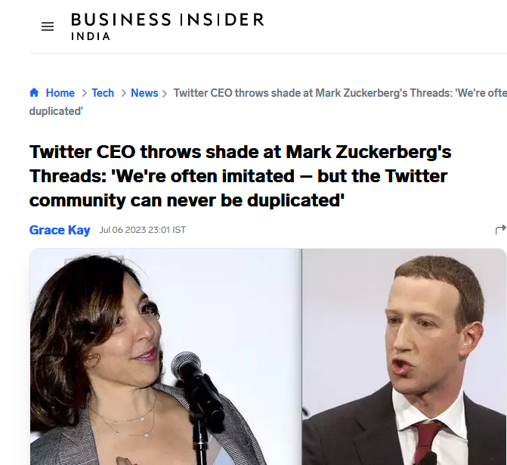
Learn an idiom
“To throw shade”

Slide 3
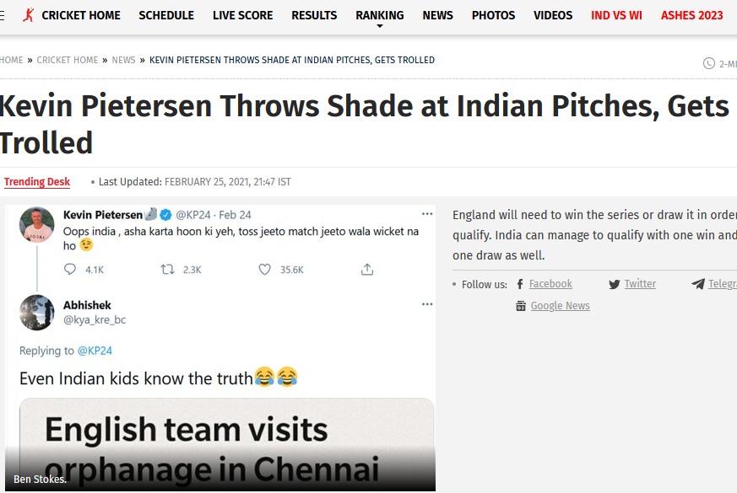
Learn an idiom
“To throw shade”

Slide 4
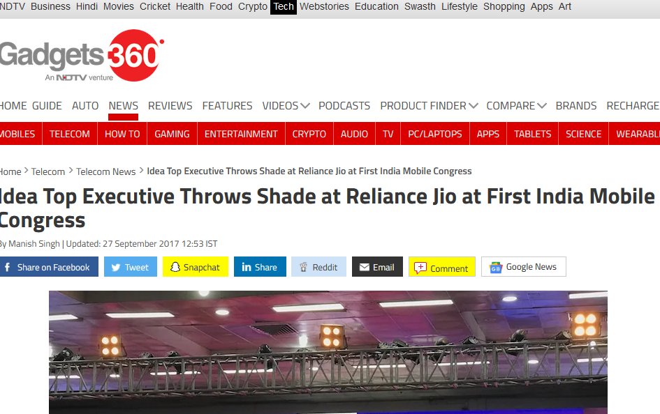
Learn an idiom
“To throw shade”

Slide 5
Learn an idiom
“To throw shade”
“to throw shade” means:
to criticize someone or something publicly and show that you do not respect them
Examples:
This isn't the first time that the actress has thrown shade at her ex-husband.
She can throw shade like no other and has feuded with some of the biggest names in the entertainment world.
I get annoyed when people throw shade on his recent work.
"How does Raj keep any friends? Last night at the party all he did was throw shade at people."

Slide 6
Learn an idiom
“To throw shade”
“to throw shade” means:
to criticize someone or something publicly and show that you do not respect them
Usages with similar meaning:
to gibe/jibe (verb, followed by the proposition ‘at’): (from news headlines): “Kangana jibes at Deepika Padukone over alleged drug use.”
Jibe (noun): Unlike many other politicians, he refuses to indulge in cheap jibes at other people’s expense.
To take a dig: The celebrity took a subtle dig at event managing company’s lack of preparedness.

Slide 7
Common mistakes among Indian English speakers
Identify the language mistake and rectify
You need not to worry about the attendance for this course.
I can’t able to make changes in the code / I can’t able to concentrate.
Anyways, I am going to call her.
Please revert back to me as soon as possible / Kindly let us know about your availability by replying back to this email.
We will be discussing about the matter in the meeting / Can I discuss about something with you now?
This language is called as Java / My native place is called as Vadodara.
I think India is going to loose the match / If you loose, I get 1000 rupees.
Years back, when I joined the company… / Years back, when India got independence…
Once again, I want to emphasize on deadlines.
We are here to celebrate the marriage anniversary of Mr. and Mrs. Kapoor.

Slide 8
Common mistakes among Indian English speakers
Correct usages
You do not need to worry about the attendance for this course. Or, You need not worry…
I am not able to make changes in the code / I can’t able to concentrate.
Anyways, I am going to call her.
Please get back to me as soon as possible / Let us know about your availability by replying to this email.
We will be discussing about the matter in the meeting / Can I discuss about something with you now?
This language is called as Java / My native place is called as Vadodara.
I think India is going to lose the match / If you lose, I get 1000 rupees. (Loose means not fastened, not rigid, not restrained).
Years ago, when I joined the company… / Years ago, when India got independence…
Once again, I want to emphasize on deadlines.
We are here to celebrate the marriage wedding anniversary of Mr. and Mrs. Kapoor.

Slide 9
Common mistakes among Indian English speakers
Identify the language mistake and rectify
We had lunch with our friends at a small roadside hotel.
Good morning, Madam! What’s your good name?
I passed out of school in 2017 and I’m doing my graduation in Surat.
“Where are you from?” “I belong to Delhi.”
I’ll speak to you later – Susmita is eating my brain here!
The entrance is on the backside of the building.
Have you got five minutes? I need one help.
Only very few people came to the bank today, so I had very less work.
I gave my English exam yesterday – it was really difficult.
“What do you want for dinner?” “Let’s order for pizza.”

Slide 10
Common mistakes among Indian English speakers
Correct usages
We had lunch with our friends at a small roadside café/restaurant.
Good morning, Madam! What’s your good name?
I passed out of finished school in 2017 and I’m doing my graduate degree in Surat.
“Where are you from?” “I’m from Delhi.”
I’ll speak to you later – Susmita is picking my brain / chewing my ears off!
The entrance is on the backside at the back of the building.
Have you got five minutes? I need some help.
Only very few people came to the bank today, so I had very little work.
I took my English exam yesterday – it was really difficult.
“What do you want for dinner?” “Let’s order for pizza.”

Slide 11
Common mistakes among Indian English speakers
Identify the language mistake and rectify
I am having four brothers and three sisters.
He do not have a laptop. / Does she has a car?
"Today office is there?" (Answer): "No office is not there. Today is Bharat bandh."
Last before year she got very good marks.
He did not wrote the test last week.
I cannot cope up with this pressure.
I came to office by walk.
What is the time in your watch?
Our classroom is in the 2nd floor.
He has white hairs.
I prefer coffee than tea.

Slide 12
Common mistakes among Indian English speakers
Identify the language mistake and rectify
I am have four brothers and three sisters.
He does not have a laptop. / Does she have a car?
"Is today a working day?" / “Are we working today?” (Answer): “No, we are not working today.”
Year before last she got good marks. (Correct phrases: Month before last, Day before last, Week before last.)
He did not write the test last week.
I cannot cope up with this pressure.
I came to office on foot.
What is the time by your watch?
Our classroom is on the 2nd floor. I am on campus. There is a chair lying around on the corridor.
He has grey hairs.
I prefer coffee to tea.

Slide 13
Lesson 1: Introducing Oneself
Follow the format given below, but feel free to improvise
Begin with:
Hi everyone
Hello friends
Good morning, everyone/Good morning, all/Good morning, guys
Proceed to: “I am ….; I come from…; my hobbies are…/ I like..; This is the first time I…”
End with pleasantries, like:
I look forward to knowing you all better
Wish you all a great time on campus
Hope you all enjoy your time in DA-IICT

Slide 14
https://www.youtube.com/watch?v=YkgkThdzX-8

